Slide 1
E-Readers…
The future of the classroom

Slide 2
Textbooks
Cumbersome
Expensive
Frequently misplaced by students
Notes:
For years, high school students have struggled with keeping up with textbooks. At Kell, students take 7 classes a day and typically each class has at least one textbook. Students struggle down the hall with heavy backpacks. Others give up completely and leave their books in a classroom, where they are frequently stolen. What can be done?

Slide 3
Classroom Printing
In addition to the cumbersome and expensive element of textbooks, classroom teachers print reams and reams of documents across the course of the school year – costing the district LOTS of money!!
Notes:
The E-reader pilot program at Princeton (2009) found that classes in which students were utilizing an e-reader printed between 38% and 53% less than traditional classes.
http://www.princeton.edu/ereaderpilot/eReaderFinalReportShort.pdf

Slide 4

Cobb County Vision
“Students will use next generation technology tools to access, analyze and apply increasingly complex information to draw conclusions and make informed decisions. “
“Students and teachers will be technologically literate and will model responsible digital citizenship through the ethical use of information”
“Students and teachers will use technology to extend learning beyond the classroom and the school day.”
http://www.cobbk12.org/centraloffice/instructionaltechnology/TechPlan/2012_2015_CCSD_District_Technology_Plan.pdf

Slide 5
E-Readers
Barnes & Noble Simple Touch
Amazon Kindle Touch
$99
More than 2.5 million titles
ePub5, PDF, JPG, GIF, PNG, and BMP, ePub
$99
More than 1 million titles
PDF, unprotected MOBI, PRC eBook formats, Doc/DocX, PDF, TXT, RTF, HTML, JPEG, GIF, PNG, and PNG
http://blog.laptopmag.com/face-off-barnes-and-noble-nook-simple-touch-vs-amazon-kindle-touch

Slide 6
E-Readers
Offer students the opportunity to keep all of their textbooks and supplemental texts in one location.
Enable students and teachers to better access a wealth of information available on the Internet.

Slide 7

The Princeton Study
Princeton University conducted a study of e-readers in three classes and found overwhelmingly that the e-readers dramatically reduced paper consumption.
While e-readers may seem to be a large purchase given our current district financial status, the cost would be offset by the reduction in paper usage and in student textbook loss.
Additionally, the use of e-readers would allow Cobb County to continue to lead the way in green initiatives!
http://www.princeton.edu/ereaderpilot/eReaderFinalReportShort.pdf

Slide 8

Creekview High School
Creekview High School in Cherokee County has already implemented the use of e-readers in their “Unquiet Library.”
Students are able to check out e-readers and utilize those for class work.
Student evaluation of this program is outstanding.
www.theunquietlibrary.libguides.com/kindles

Slide 9

Implementation Plan
Cobb County should begin by purchasing e-readers for the high school students of school year 2014-2015 utilizing SPLOST funds and/or textbook funds.
This will enable us to better facilitate training opportunities for teachers.
Technology lead teachers will be designated at each high school to assist county instructional technology employees in training and rollout.

Slide 10
Implementation Plan
The following year, 2015-2016, e-readers will be purchased for the middle schools with top teachers in the high schools assisting with training for the middle school teachers.
During the 2016-2017 school year, e-readers will be purchased for the elementary schools, with one classroom set being purchased for each teacher.

Slide 11

Limitations
Although e-readers are potentially as subject to loss as textbooks, students will no longer be tasked with keeping up with multiple texts. Instead, they will have one e-reader with all of their courses’ texts.
Just as with textbooks currently, once an e-reader is issued to a student, that student and his parents become responsible for replacement cost or repair.

Slide 12
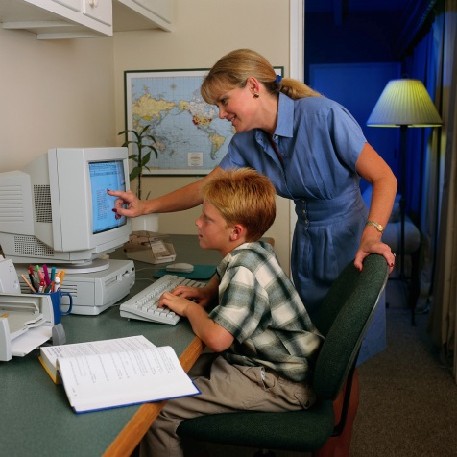
Limitations
Students will most likely be excited about the incorporation of new technology; however, staff and parents may have a more difficult time with this.
Training opportunities for parents will take place during pre-planning days with specific days designated for each high school.
Training for staff will be ongoing, beginning with the 2014 post-planning.

Slide 13

Classroom Use
Addressing content and technology standards:
  No longer will teachers struggle to get students to bring their textbooks. E-readers are easily accessible and will allow teachers to integrate web searches with textbook resources.

Slide 14

Classroom Use
Addressing specific student learning goals:
  Scientific inquiry and authentic learning – E-readers will allow students to use up-to-date technology currently being utilized in the professional world.
  Project-based learning and collaborative learning – E-readers will allow students with little home technology access to become more familiar with necessary technology skills and facilitate group projects.

Slide 15

Classroom Use
Addressing specific student learning goals:
  Research-based learner-centered strategies – E-readers eliminate traditional student excuses for why they do not have their textbooks or why it is impossible for them to research at home. E-readers provide this opportunity thereby placing more emphasis on student-centered learning.

Slide 16
Classroom Use
Differentiating student instruction:
  Text-to-sound software is currently being used by many students with IEPs in the county. By providing e-readers to all students and training to all teachers, teachers will be better able to accommodate every student in their classes.
  Opportunities for enrichment abound with e-readers. Students will have current newspapers, magazines, videos, and books at their fingertips ready to download which will allow them to explore topics of interest.

Slide 17
Classroom Use
Promoting communication:
  Access to e-readers by every student guarantees blog access on a daily basis for every student.
  Additionally, e-readers will facilitate discussion board access and incorporation into every class.
  Currently, the district drive is to incorporate more Cobb Virtual Academy classes into every student’s high school career. E-readers will allow students to access their online courses as well.

Slide 18

E-Readers are the Future
A 2012 Huffington Post survey found that “21% of Americans had read an e-book and that owners of e-readers read an average of eight books more a year than people without the devices (24 vs. 16).”
E-readers facilitate the act of reading by making it more convenient.
http://www.huffingtonpost.com/2012/04/05/ereaders-ebooks-survey-how-many-people-read_n_1405449.html

Slide 19
Reflection
What I learned is that there is already a strong movement towards incorporating e-readers into the classroom. While my plan may seem to be too large in scope, I truly believe that textbook losses and textbook replacement funds would more than compensate for the slow rollout I envision. Over the course of the next five years, we could see a dramatic movement towards the every day incorporation of technology in our classrooms.

Slide 20
Reflection
(continued)
Professionally, I do not think I realized what actually goes into someone in the district envisioning the incorporation of new technology. I have always been on the receiving end of new training about new technology. In the future, I know that I will be a great deal more patient with training, and I am sincerely looking forward to assisting with that training in my own building.

